Slide 1
LC-ICPMS-ESIMS Feature detection
LC_ICPMS_ESIMS_isotopes_pattern_search_v2_2.R
Updated 1/13/2022 (R. Boiteau

Slide 2
Requirements:
Download and install:
R: https://www.r-project.org/
R studio: https://rstudio.com/
In R, install XCMS package: https://bioconductor.org/packages/release/bioc/html/xcms.html

Slide 3
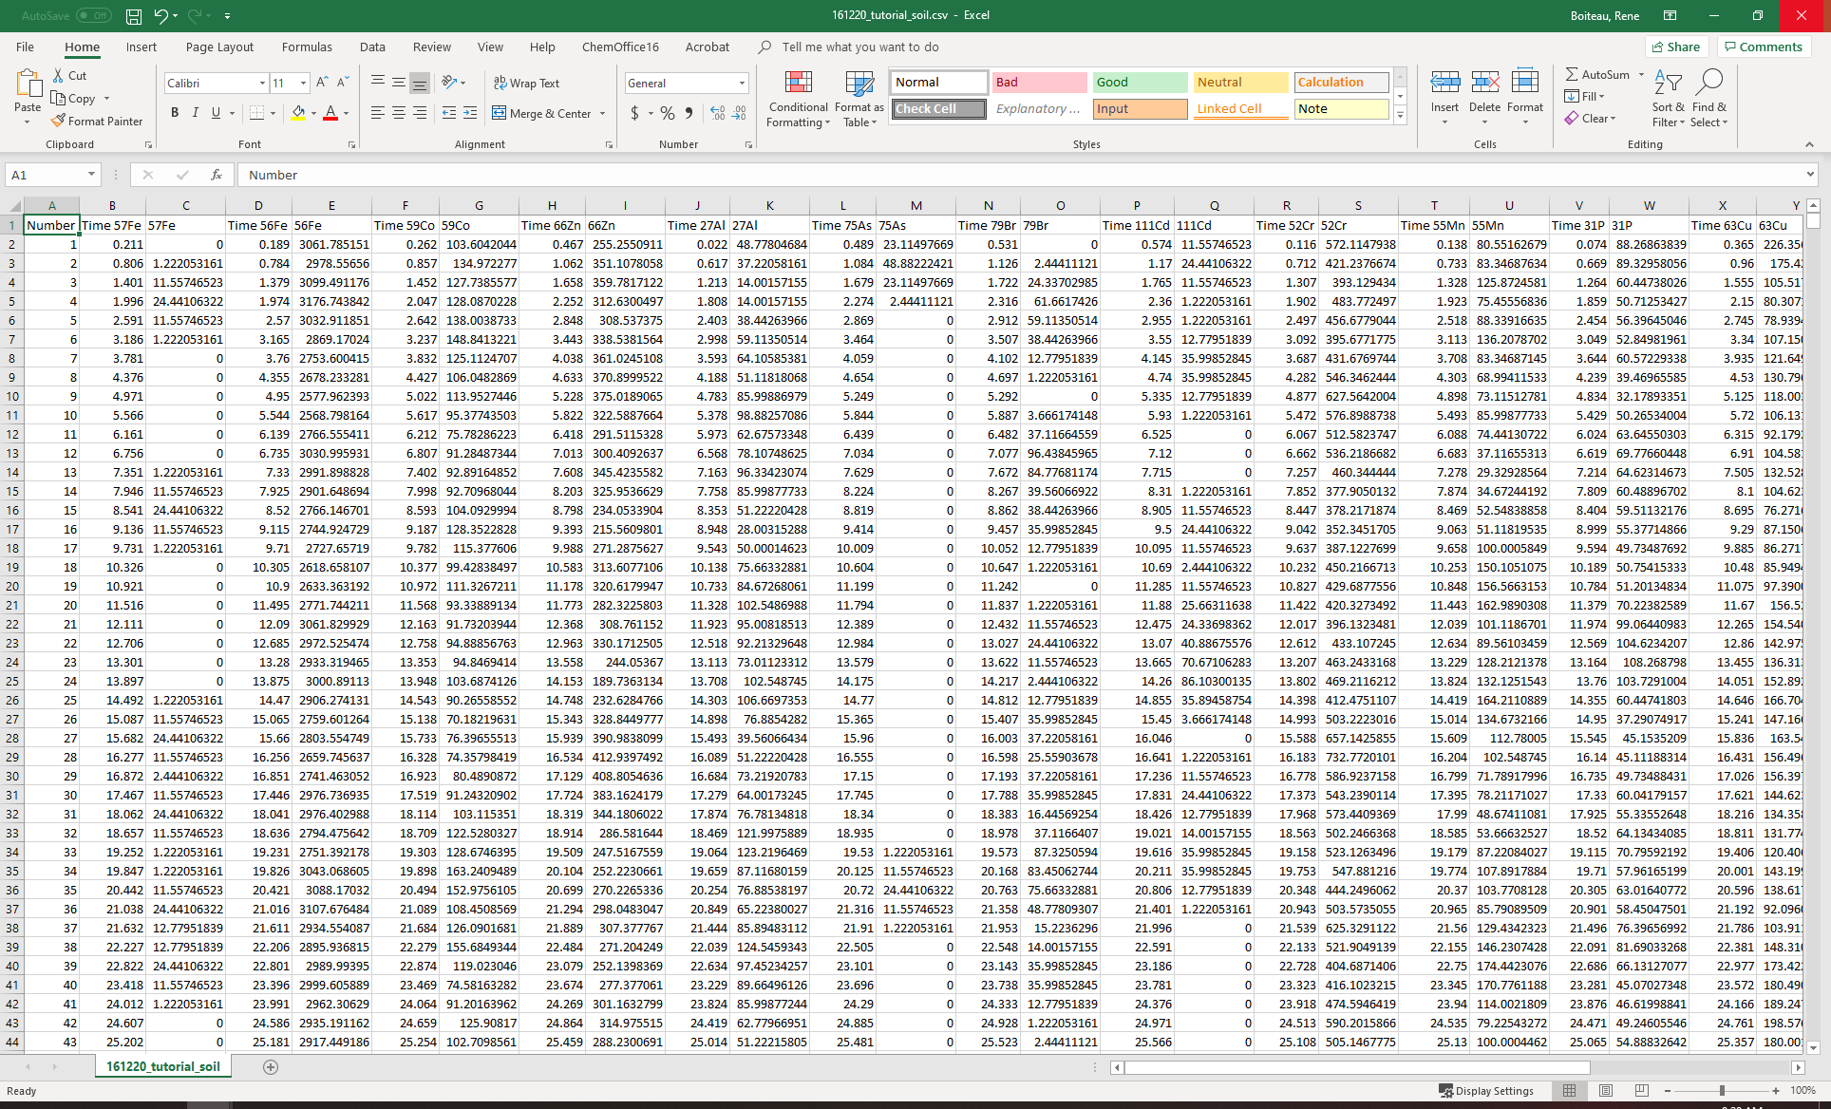
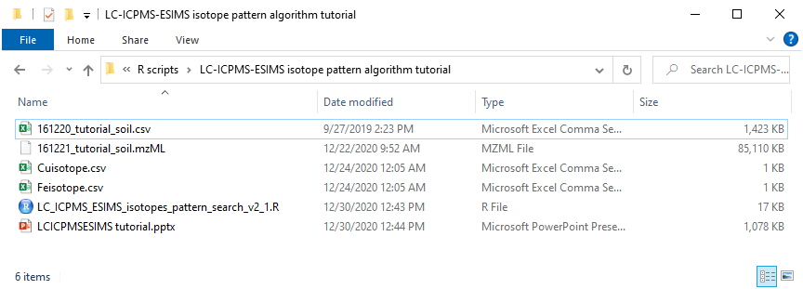
(1) Create folder with function files, isotope pattern files, and data files
ICPMS data requires these headers (default export from Qtegra), or the ‘ICPread’ function of the script must be modified.

Slide 4
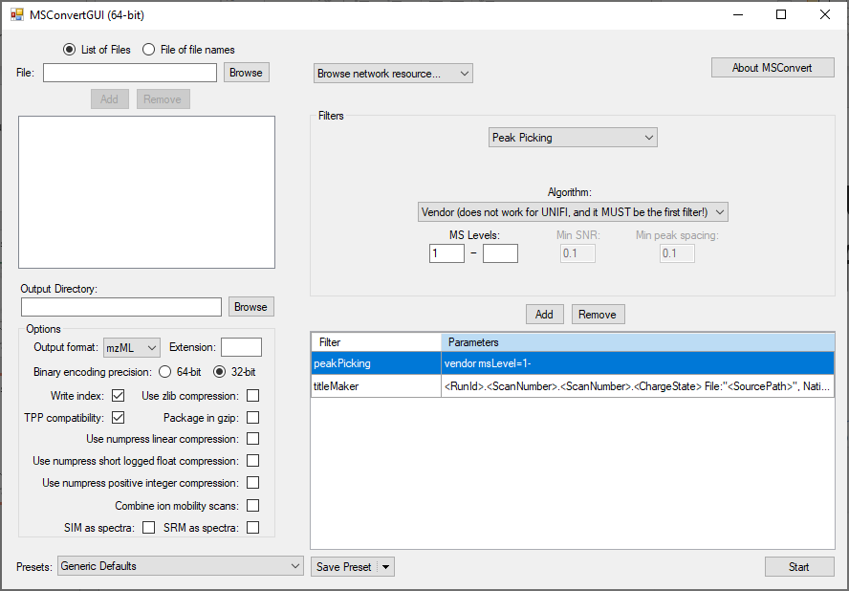

(1) Create folder with function files, isotope pattern files, and data files
Convert .RAW files from orbitrap to mzML files with MSConvert
http://proteowizard.sourceforge.net/tools.shtml

Slide 5
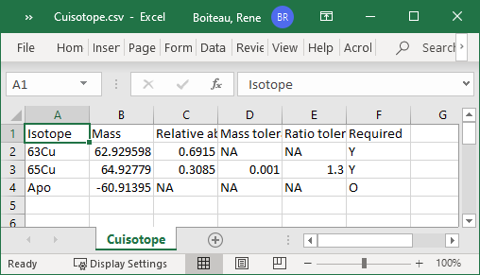
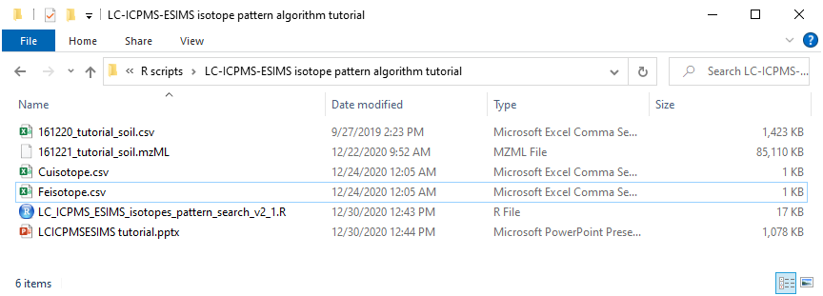
(1) Create folder with function files, isotope pattern files, and data files
Isotope pattern file format (.csv file)
Isotope: Must have at least two rows
Masses: Algorithm uses differences between each row
Relative abundance: Algorithm uses ratio between each row
Mass tolerance #: Peak pairs will be picked if Δm/z is within a window ± this # (first row isn’t used)
Ratio tolerance #: Peak pairs will be picked if Light/Heavy is within a factor of this # (first row isn’t used)
Required?: ‘Y’ if used to pick peaks, ‘N’ if only plotted, ‘O’ if adduct.

Slide 6
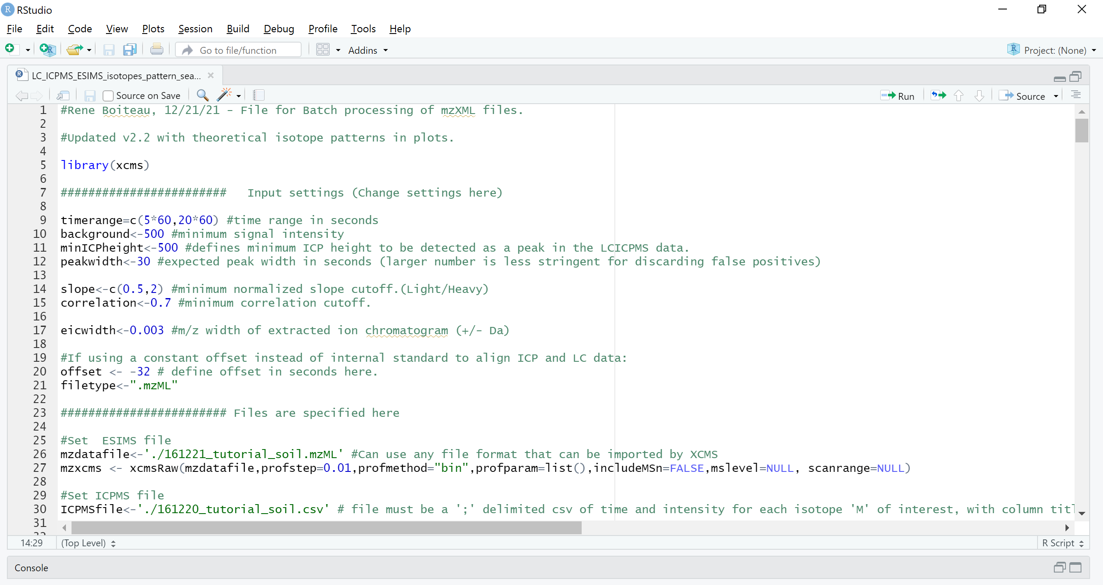
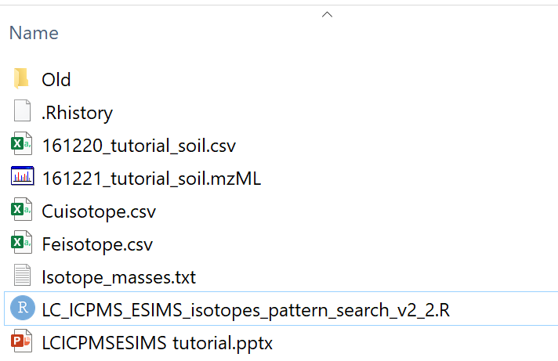
(2) Open template file in R-Studio

Slide 7
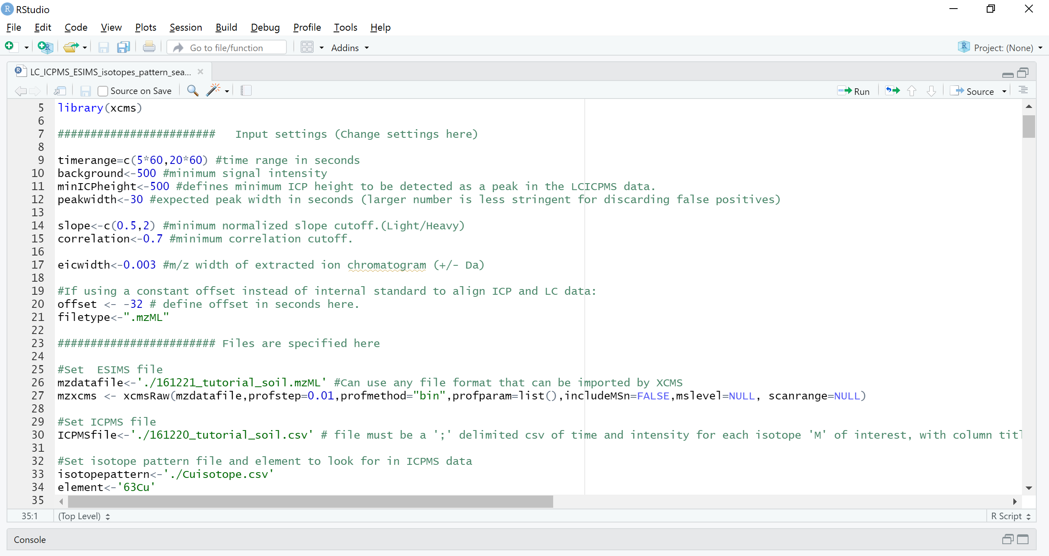
(3) Edit parameters and file names

Slide 8
(4) Press ‘source’ to run program

Slide 9
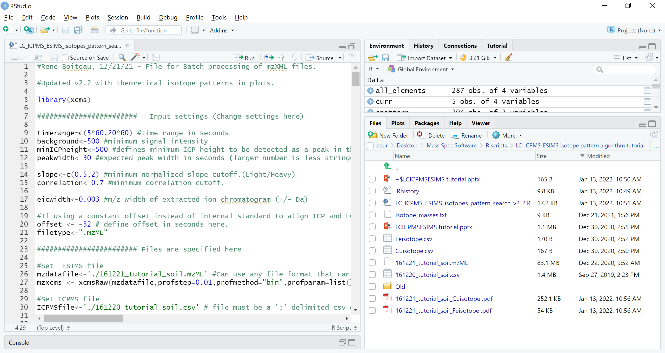
(5) Program generates report pdf

Slide 10
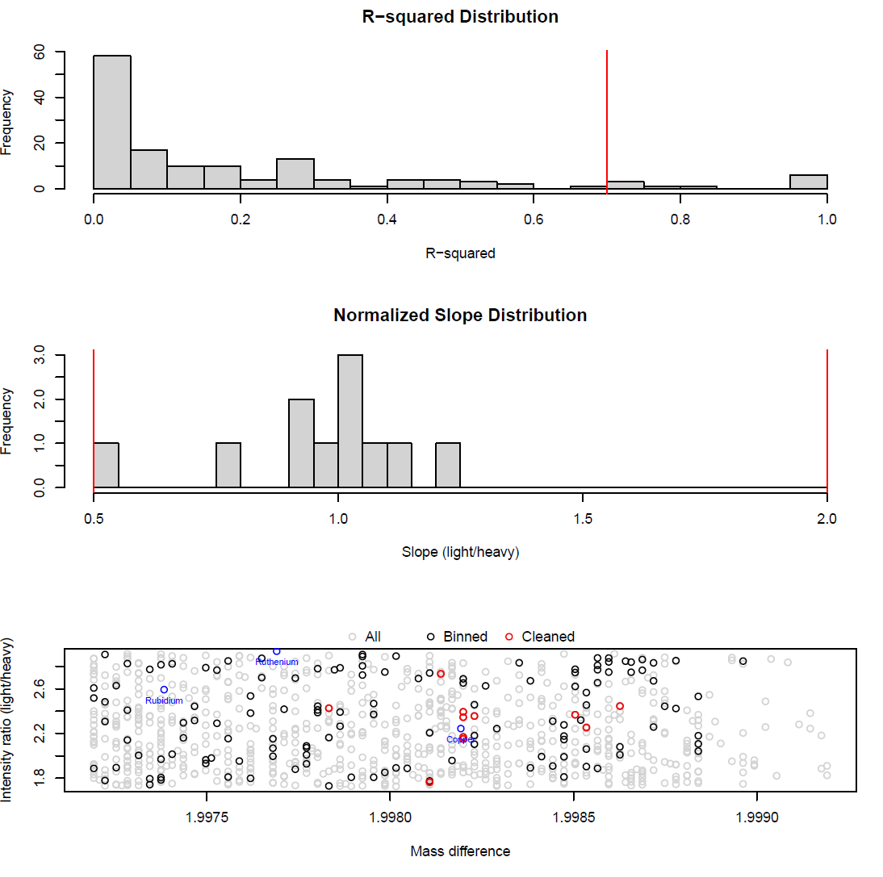
Report format: global QC
r² min cutoff
For every MS feature that matches the pattern,
An r² value is calculated across time
Slope (ratio of light/heavy isotopes normalized to expected value)
Slope cutoffs
Gray = all pattern-matched features detected
Black = maximum intensity features after binning
Red = validated features after r² and slope cutoff
Blue = True metal isotope patterns.

Slide 11
Report format: Validated features
ICPMS chromatogram with detected peak maxima
EIC of validated features, with intensities scaled to
overlap relative abundances
EIC of optional forms
MS of retention time corresponding to maximum peak
Red lines = true data, gray bar = expected pattern

